Slide 1
Diffie-Hellman Key Exchange
-Igneta mclUren dsouza
CNE
Notes:
<number>

Slide 2
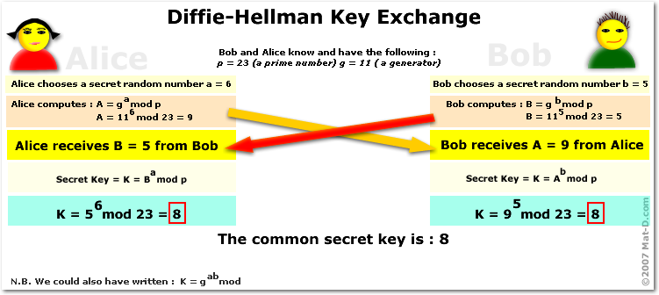
Introduction
Two parties – no prior knowledge of each other to establish together a shared secret key over an insecure communications channel.
Whitfield Diffie and Martin Hellman in 1976.
Depends for its difficulty of computing discrete logarithms.
Notes:
<number>

Slide 3
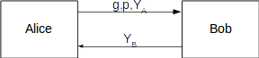
Diffie Hellman Key Exchange Protocol
Y_{A} = g^{XA} mod p
Y_{B} = g^{XB} mod p
(Y_{B})^{XA} mod p
(Y_{A})^{XB} mod p
Notes:
<number>

Slide 4
Literature Survey
Research on Diffie-Hellman Key Exchange Protocol
Diffie-Hellman’s Features
Secret keys are created only when needed.
The exchange requires no pre existing infrastructure.
It is computationally intensive.
Improved Diffie-Hellman key exchange protocol based on hash function.
Notes:
<number>

Slide 5
Literature Survey
Network-Specific Attacks on Diffie-Hellman Key-Exchange in Commercial Protocols
Attacks on Mathematical Structure of DH
Degenerate message attacks
Simple exponent attack
Simple substitution attack
Attacks on Implementation Detail of DH
Obtaining ephemeral secret from memory
Timing attack
Notes:
<number>

Slide 6
Literature Survey
Network Attacks of DH Integration in Protocols
Man-In-The-Middle
Denial-Of-Service
Replay attack
Notes:
<number>

Slide 7
Literature Survey
Secure Key Exchange Algorithm - Mathematical Approach
Timestamps to prevent Replay attacks
Cryptanalysis and Security Enhancement of Two Advanced Authentication Protocols
Add a cookie exchange
Notes:
<number>

Slide 8
Literature Survey
Enhanced Security Mechanism In Public Key Cryptosystems Using Biometric Person Authentication
Biometric based sender authentication.
Notes:
<number>

Slide 9
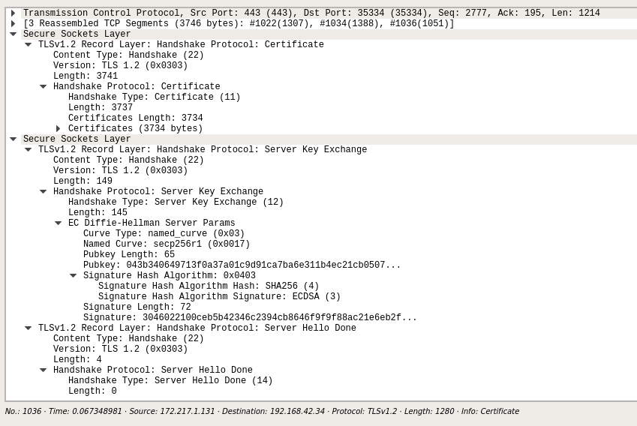
Applications
Secure Sockets Layer (SSL)
Secure Shell (SSH)
IPSec
Notes:
<number>

Slide 10
Objective
Widely used in network security protocols
DH is vulnerable to some concerning mathematical, implementation-related and network-specific attacks.
Defending against these attacks is important in secure implementation of DH in network protocols.
The objective of the proposed system is to defend against clogging attack.
Notes:
<number>

Slide 11
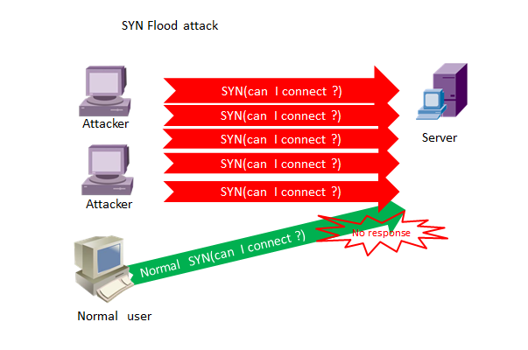
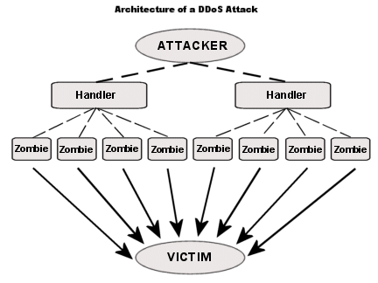
Clogging Attack
Notes:
<number>

Slide 12
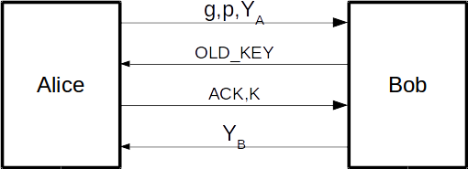
Design
Bob sets a threshold value T for each user.
When the number of requests reaches T within a particular time t, Bob sends a OLD_KEY request to the user for which the user must acknowledge with the old shared key within response time.
Bob sets a timer for each user, where it processes the public key request only at particular intervals of time for that user.
Notes:
<number>

Slide 13
Result and Analysis
Possibilities to carry out clogging attack
Spoof IP Address
Attacked entity will return OLD_KEY request to wrong IP address on reaching T
True IP, Random Keys
No shared key for acknowledgement.
Compromised host
Timer for computing modular exponentiation.
Notes:
<number>

Slide 14
Reference
[1] Iraj Fathirad, John Devlin,Network-Specific Attacks on Diffie-Hellman Key-Exchange in Commercial Protocols,2016,lCCPEIC
[2] Nan Li,Research on Diffie-Hellman Key Exchange Protocol,IEEE
[3] Sakthi Nathiarasan A,Advanced Research in Computer Science and SoftwareEngineering,2013
[4] S. Raghu Talluri,Cryptanalysis and Security Enhancement of Two Advanced Authentication Protocols,2014
[5] Rolf Oppliger,Protecting Key Exchange and management Protocols
[6] Jitendra Singh Laser,Enhanced Security Mechanism In Public Key Cryptosystems Using Biometric Person Authentication,2016,lCCPEIC
Notes:
<number>

Slide 15
Reference
[7] Jean-François Raymond,Security Issues in the Diffie-Hellman Key Agreement Protocol
[8] Maryam Ahmed,Diffie-Hellman and Its Application in Security Protocols,2012,IJESIT
[9] Aqeel Sahi Khader,Preventing Man-In-The-Middle Attack in Diffie-Hellman Key Exchange Protocol,2015,IEEE
[10] Prashant Rewagad,Use of Digital Signature with Diffie Hellman Key Exchange,2013
Notes:
<number>

Slide 16
THANK YOU
Notes:
<number>

Slide 17
Questions?
Notes:
<number>

